Slide 1

Final Year Briefing
Dr Shirley Atkinson
Associate Head of Computing

Slide 2
Agenda
Outline arrangements for next academic year
Degree titles
Final stage options
Final year project
Delivery
Q & A

Slide 3
Degree titles
BSc (Hons) Computer Science
BSc (Hons) Computer Science (Software Engineering)
Replaces BSc (Hons) Computing and Software Development
BSc (Hons) Computer Science (Cyber Security)
Replaces BSc (Hons) Cyber Security
BSc (Hons) Computer Science (Games Development)
Replaces BSc (Hons) Games Development Technologies
BSc (Hons) Computer Science (Artificial Intelligence)
Brand new!
Existing titles remain – to be taught out

Slide 4
Transfering
Students can transfer to new titles if they wish
They don’t have to.
To transfer email
Science.Engineering@plymouth.ac.uk
quoting your Student Reference Number and request to be transferred from your existing programme, so that your provisional enrolment can be set up on the new programme
New titles have OPTIONS!

Slide 5
Options are back!
We listened… we managed to get it sorted..
BSc (Hons) Computer Science
Complete freedom of choice over options – four options out of seven
BSc (Hons) Computer Science (X)
Will be able to choose one option in each semester
I will answer questions about options at the end

Slide 6
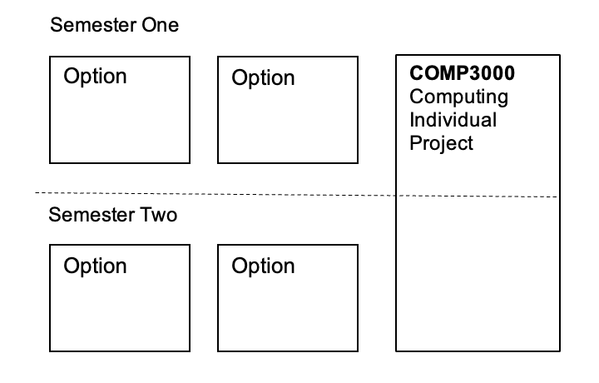
BSc Computer Science
Module Code | Title
COMP3001 | Parallel Computing | S1 | Vasilios
COMP3003 | Machine Learning | S1 | Lingfen
COMP3006 | Full Stack Development | S1 | David
COMP3010 | Security Operations and Incident Management | S1 | Asad
COMP3016 | Immersive Game Technologies | S1 | Swen
COMP3017 | Computing Project Management | S1 | Shirley
COMP3002 | Alternative Computing Paradigms | S2 | Thomas
COMP3004 * | Advanced Computing and Networking Infrastructures | S2 | Lingfen
COMP3007 | HCI, Usability and Visualisation | S2 | Liz
COMP3008 * | Big Data Analytics | S2 | Marco
COMP3011 | Ethical Hacking | S2 | Nathan & Bogdan
COMP3012 | Digital Forensics and Malware Analysis | S2 | Nathan
COMP3015 | Games Graphics Pipelines | S2 | Marius
Notes:
* Means you cannot have these two together… they cannot be timetabled together.

Slide 7
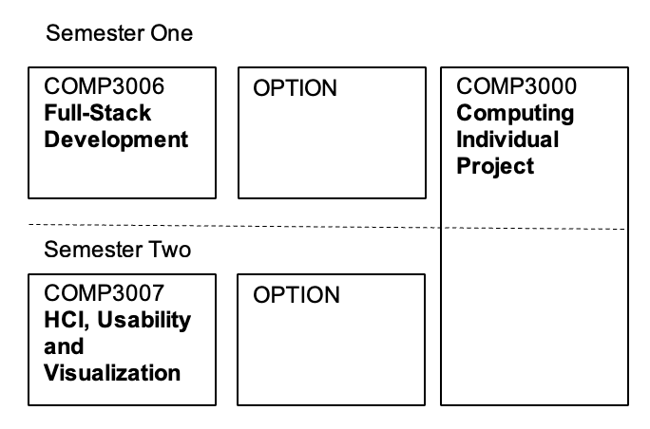
BSc Computer Science (Software Engineering)
Module Code | Title
COMP3016 | Immersive Game Technologies | S1 | Swen
COMP3017 | Computing Project Management | S1 | Shirley
COMP3008 | Big Data Analytics | S2 | Marco
COMP3015 | Games Graphics Pipelines | S2 | Marius

Slide 8
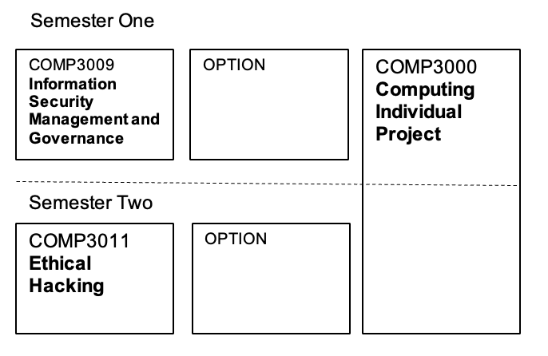
BSc Computer Science (Cyber Security)
Module Code | Title
COMP3003 | Machine Learning | S1 | Lingfen
COMP3010 | Security Operations and Incident Management | S1 | Asad
COMP3008 | Big Data Analytics | S2 | Marco
COMP3012 | Digital Forensics and Malware Analysis | S2 | Nathan

Slide 9
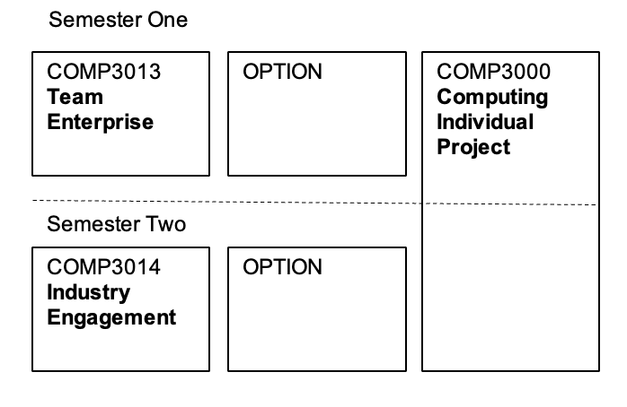
BSc Computer Science (Games Development)
Module Code | Title
COMP3006 | Full Stack Development | S1 | David
COMP3016 | Immersive Game Technologies | S1 | Swen
COMP3007 | HCI, Usability and Visualisation | S2 | Liz
COMP3015 | Games Graphics Pipelines | S2 | Marius

Slide 10
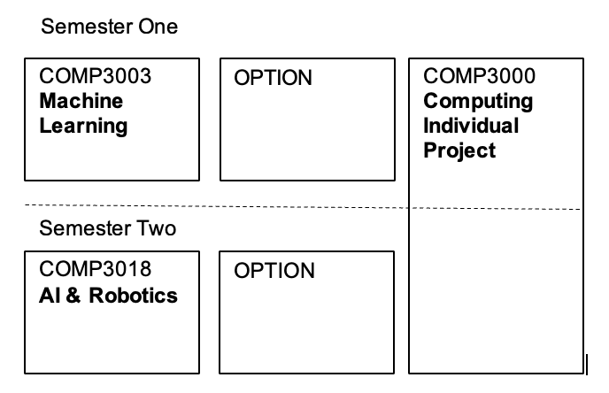
BSc Computer Science (Artificial Intelligence)
Module Code | Title
COMP3001 | Parallel Computing | S1 | Vasilios
COMP3006 | Full Stack Development | S1 | David
COMP3002 | Alternative Computing Paradigms | S2 | Thomas
COMP3008 * | Big Data Analytics | S2 | Marco
Notes:
* Means you cannot have these two together… they cannot be timetabled together.

Slide 11
Final Year Project
Need to start thinking of what you want to do
Needs to be unique to you
On 1st August you will see DLE site for next academic year
Will be ideas on there from staff
Project requires coding but you can do a research focused project
Will be a briefing in the first week of the academic year in September
I am also running “match-making” slots – keep an eye out on Computing Degrees teams site for booking

Slide 12

Any Questions?

